Slide 1
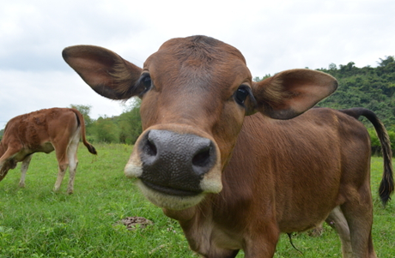
Beef crisis

Slide 2
Structure
1. The relatinship between global warming and stockbreeding
2. My Suggest
3. Q & A

Slide 3
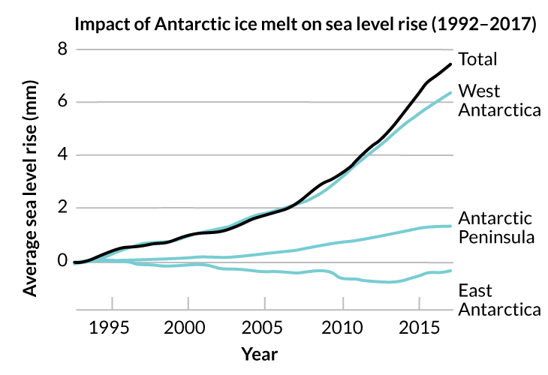
Melting ice in Antarctica has been fueling global sea level rise for a while. But that melting has sped up in the past five years. Most of the ice loss is happening in West Antarctica.
A. Shepherd et al/Nature 2018

Slide 4
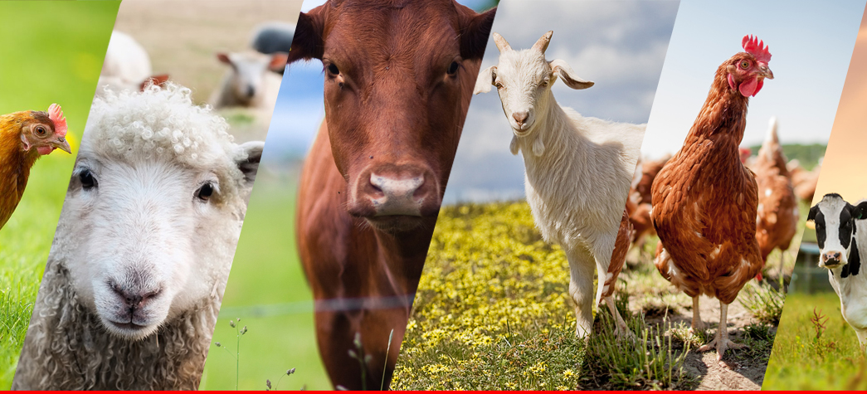
51.2%
Resource:
Herrero, M., Gerber, P., Vellinga, T., Garnett, T., Leip, A., Opio, C., ... & Montgomery, H. (2011). Livestock and greenhouse gas emissions: The importance of getting the numbers right. Animal Feed Science and Technology, 166, 779-782.

Slide 5
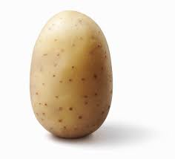
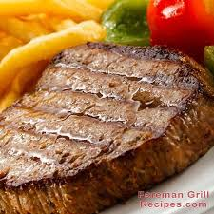
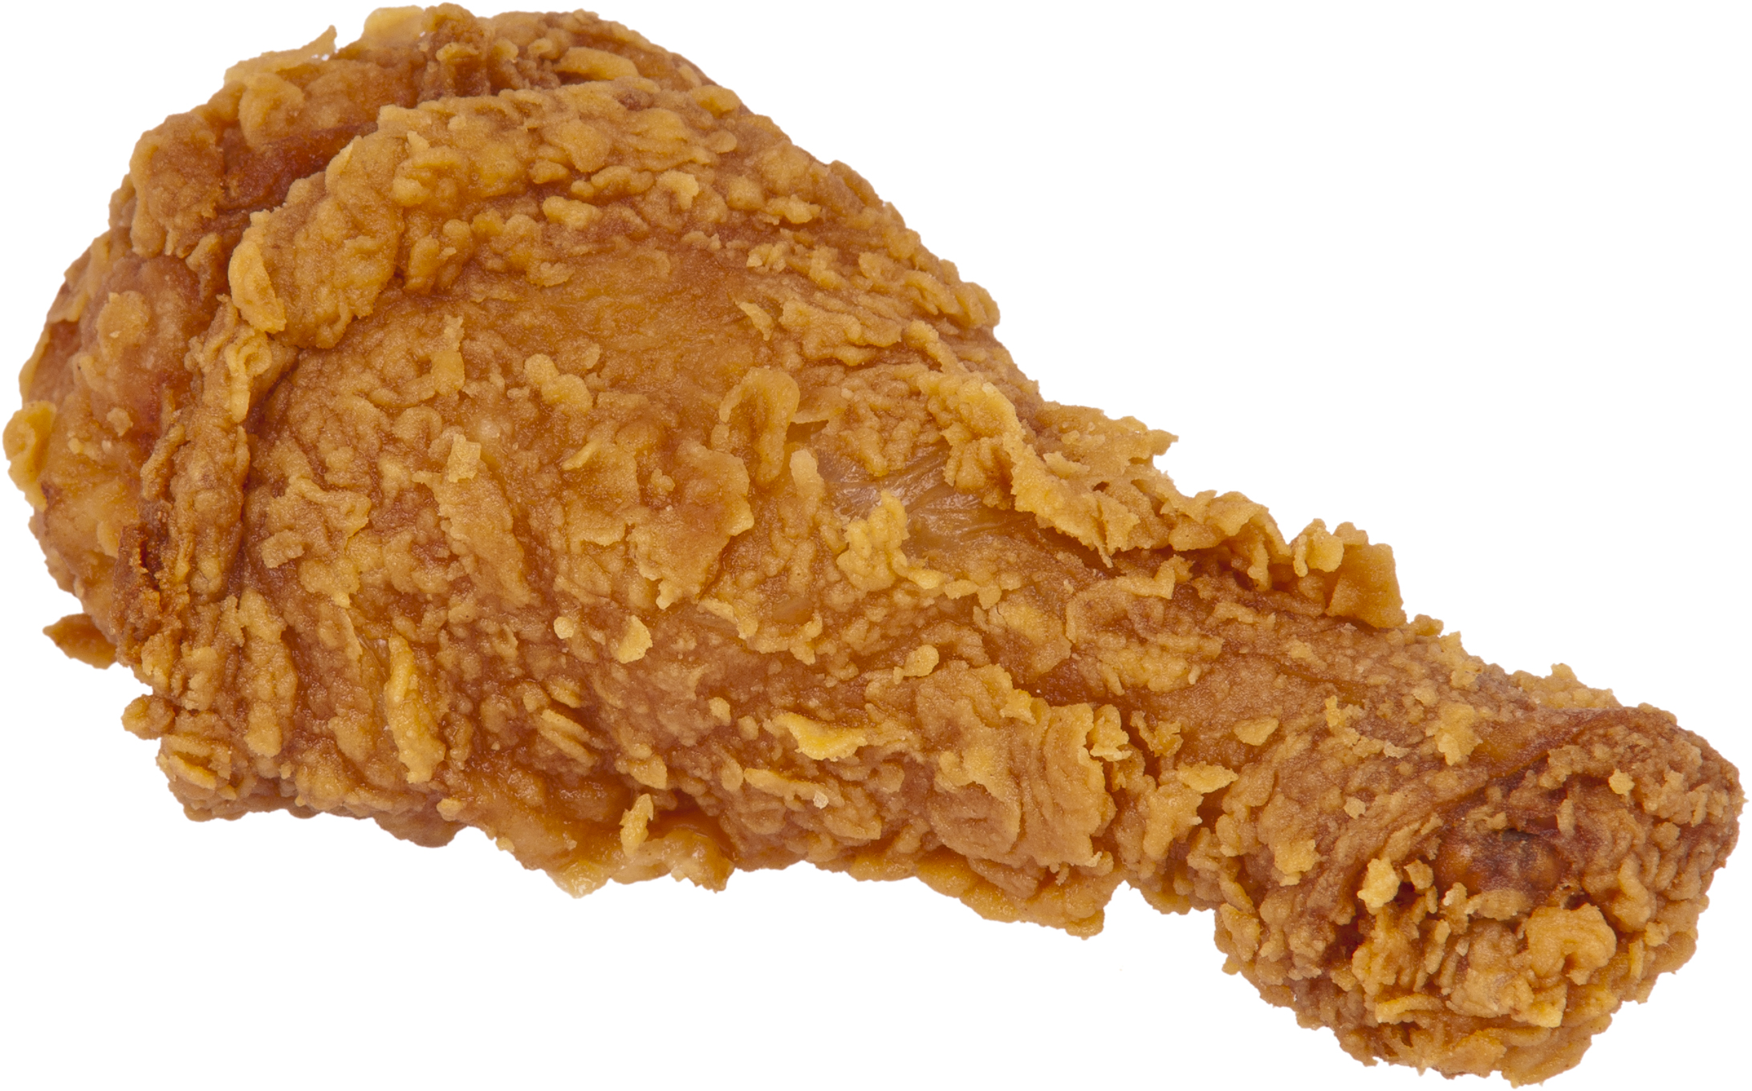
Enviromential Cost of consuming meat
13 Times
Same weight
57 Times
Same weight

Slide 6
Suggestions
Eating less meat
Buy locally produced Food

Slide 7
References:
1.Klink, C. A., & Machado, R. B. (2005). Conservation of the Brazilian cerrado. Conservation biology, 19(3), 707-713.
2.Herrero, M., Gerber, P., Vellinga, T., Garnett, T., Leip, A., Opio, C., ... & Montgomery, H. (2011). Livestock and greenhouse gas emissions: The importance of getting the numbers right. Animal Feed Science and Technology, 166, 779-782.
3.Crutzen, P. J., Aselmann, I., & Seiler, W. (1986). Methane production by domestic animals, wild ruminants, other herbivorous fauna, and humans. Tellus B: Chemical and Physical Meteorology, 38(3-4), 271-284.

Slide 8
Thanks!

